Slide 1


Cumberland
Disaster Recovery Coalition
(CDRC)
Surviving and Recovering after hurricane Florence
This Photo by Unknown Author is licensed under CC BY-NC

Slide 2

We Are Cumberland Strong
Cumberland Disaster Recovery Coalition

Slide 3
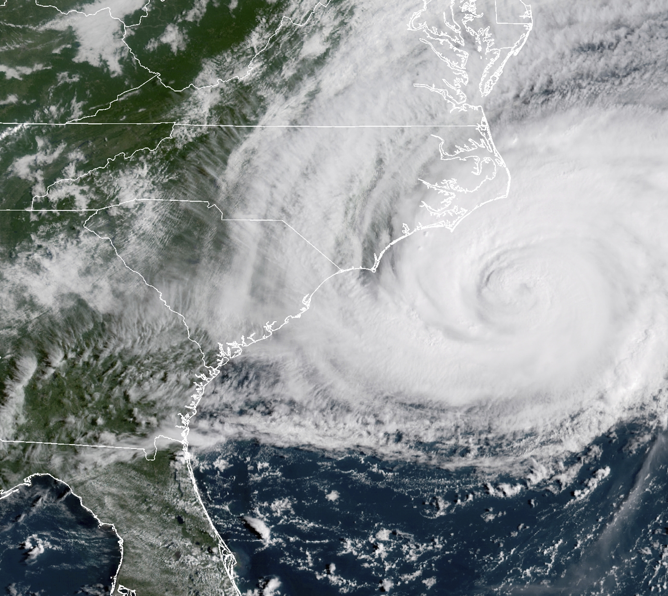
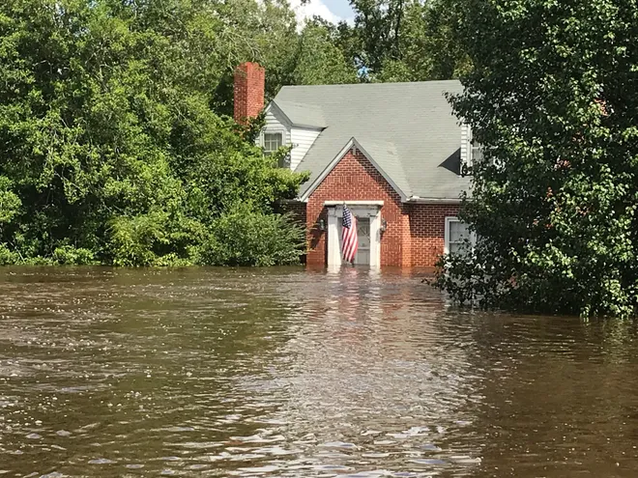
September 14, 2018, Hurricane Florence Makes Landfall

Slide 4
Cumberland Disaster Recovery Coalition Mission Statement
The mission of Cumberland Disaster Recovery Coalition (CDRC) is to assess unmet needs and provide Cumberland County residents access, coordination and education of available resources in a long-term disaster caused recovery.
(Spanish)
La misión del CDRC es evaluar las necesidades no satisfechas de los sobrevivientes de desastres y proporcionar a los residentes del Condado de Cumberland acceso, coordinacion, y educacion a los recursos disponibles de los recursos disponibles durante un desastre a largo plazo.
Hablamos español y estamos aquí para ayudarlo, departe de nuestra familia a la suya.
https://www.facebook.com/pg/CDRC.NC/about/

Slide 5
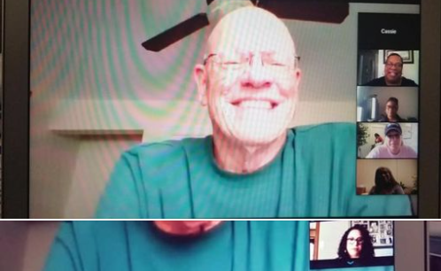
CDRc a non-profit organization
PEOPLE HELPING PEOPLE TO REBUILD AFTER A DISASTER
LTRG (Long-term recovery group)
Unmet needs committee
The Cumberland Disaster Recovery Coalition (CDRC) is a long-term recovery group (LTRG) that formed as a result of the April 16, 2011, tornado event in Cumberland County.
The CDRC is a representation of nonprofits, faith-based and charitable organizations working together to meet the unmet needs of Cumberland County residents affected by State and Federally declared disasters.
The CDRC works in collaboration with other organizations to assess the needs, offer resources and ensure that residents are helped after all personal insurance, SBA loans, and FEMA help have been exhausted.
We have a great community of concerned citizens as well as churches, businesses, faith-based organizations, government agencies and non-profits to lead the way and participate in the CDRC.

Slide 6

Contact Information
Email: Program Coordinator: director@cdrcnc.org
Office: (910) 491-3694 (please leave a message, if no answer).
Hablamos español y estamos aquí para ayudarlo, departe de nuestra familia a la suya.
Mail:
CDRC
P.O. Box 702, Fayetteville, NC 28302
or Visit (by appointment) at:
3203 Ramsey St, Fayetteville, NC 28301 (Peace Presbyterian Church)
Office Hours are limited and unpredictable, please make an appointment.
Due to COVID-19 Mask is required

Slide 7

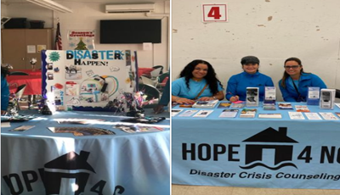
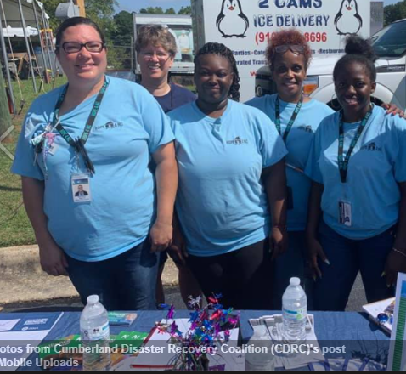
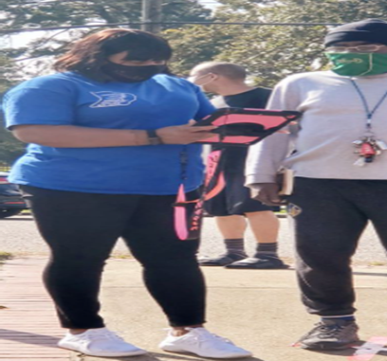
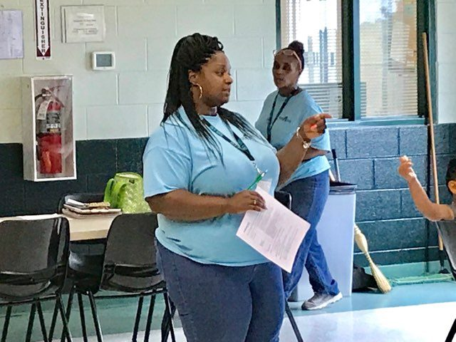
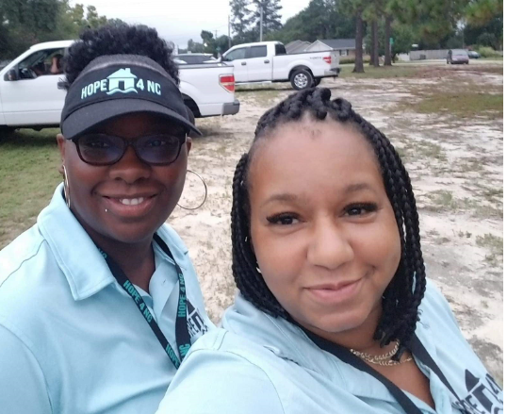
Hope4NC
Disaster Crisis Counseling
Hope4NC sponsored by Alliance was coordinated by CDRC.
Crisis Counselors canvassed all of Cumberland County, connecting disaster survivors to resources and mental health assistance through Alliance Health 24-hour hotline.
Crisis Counselors were proactive, engaging Cumberland County residents, proving information at designated events and preparing residents for Hurricane Preparedness.

Slide 8
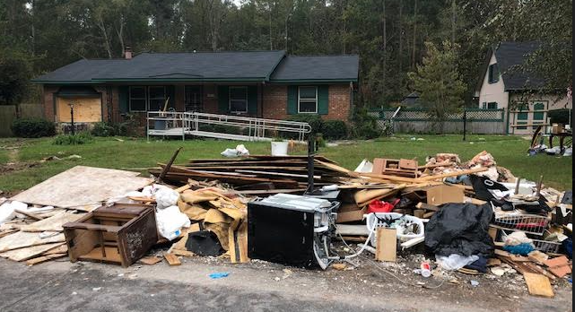
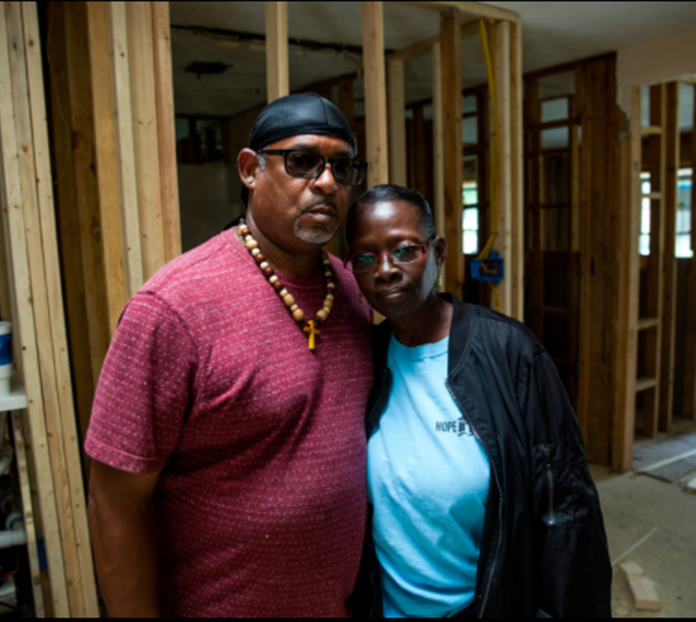
2018, Hurricane Florence Survivors:
Lloyd and Regina Evans
Friday, March 15, 2019
“Where can I turn next? Where can I go next? I pray so much I should walk around with knee pads on,” exclaimed Evans after Hurricane Florence flooded her home.
The saying goes, Mother Nature is a force to be reckoned with. But when it comes to recovery from Hurricane Florence, Regina Evans plans to put up a fight.
Copyright © 2020 WTVD-TV. All Rights Reserved.

Slide 9
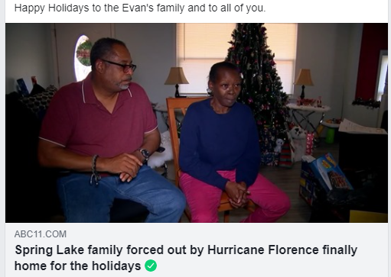

“One Year, One Month, Twenty-Seven Days Eight Hours”
“Hurricane Florence came in and left 5 feet 10 inches of water”
“Not being able to live here. You have to pay rent, mortgage. You’re trying to get your life in order and stay grounded. It was a lot,” said Regina Evans
Our family is grateful to Habitat for Humanity and Cumberland Disaster Recovery Coalition (CDRC), we would not be home for the holidays if not for the hard work and dedication of these agency.

Slide 10
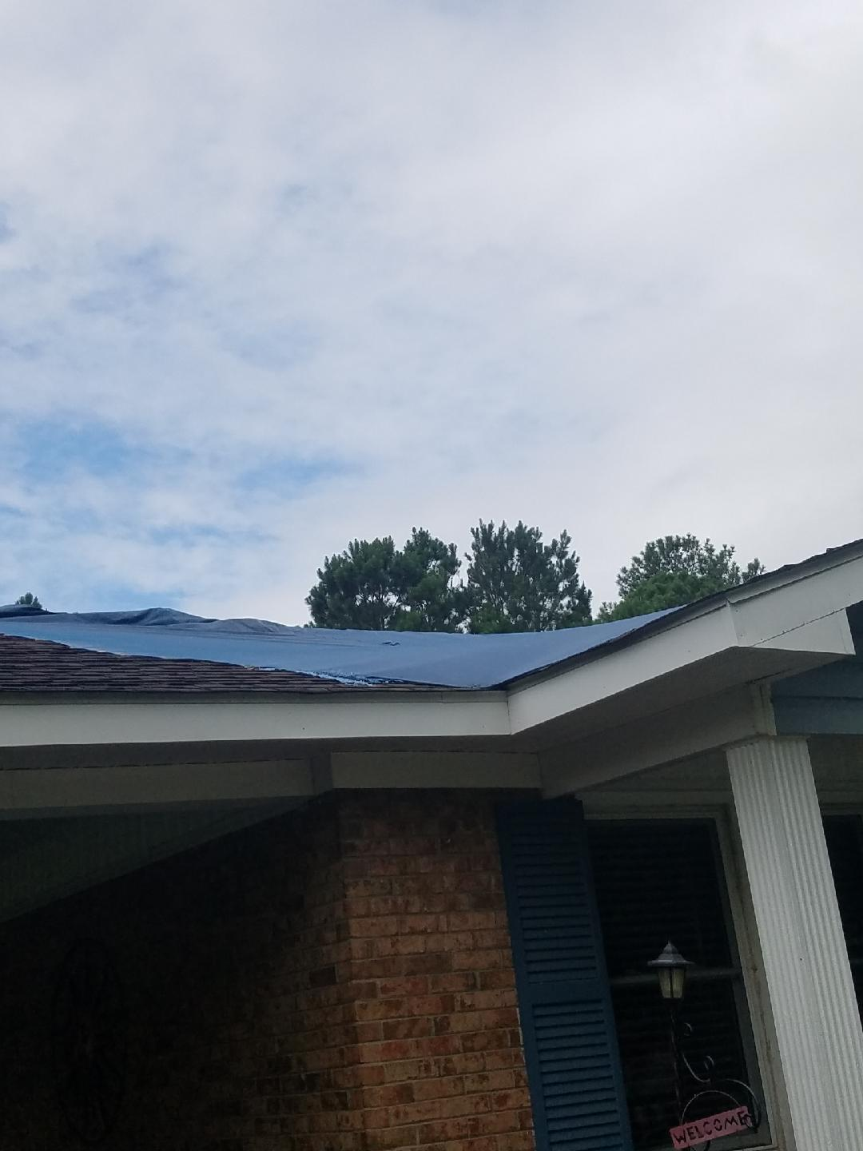
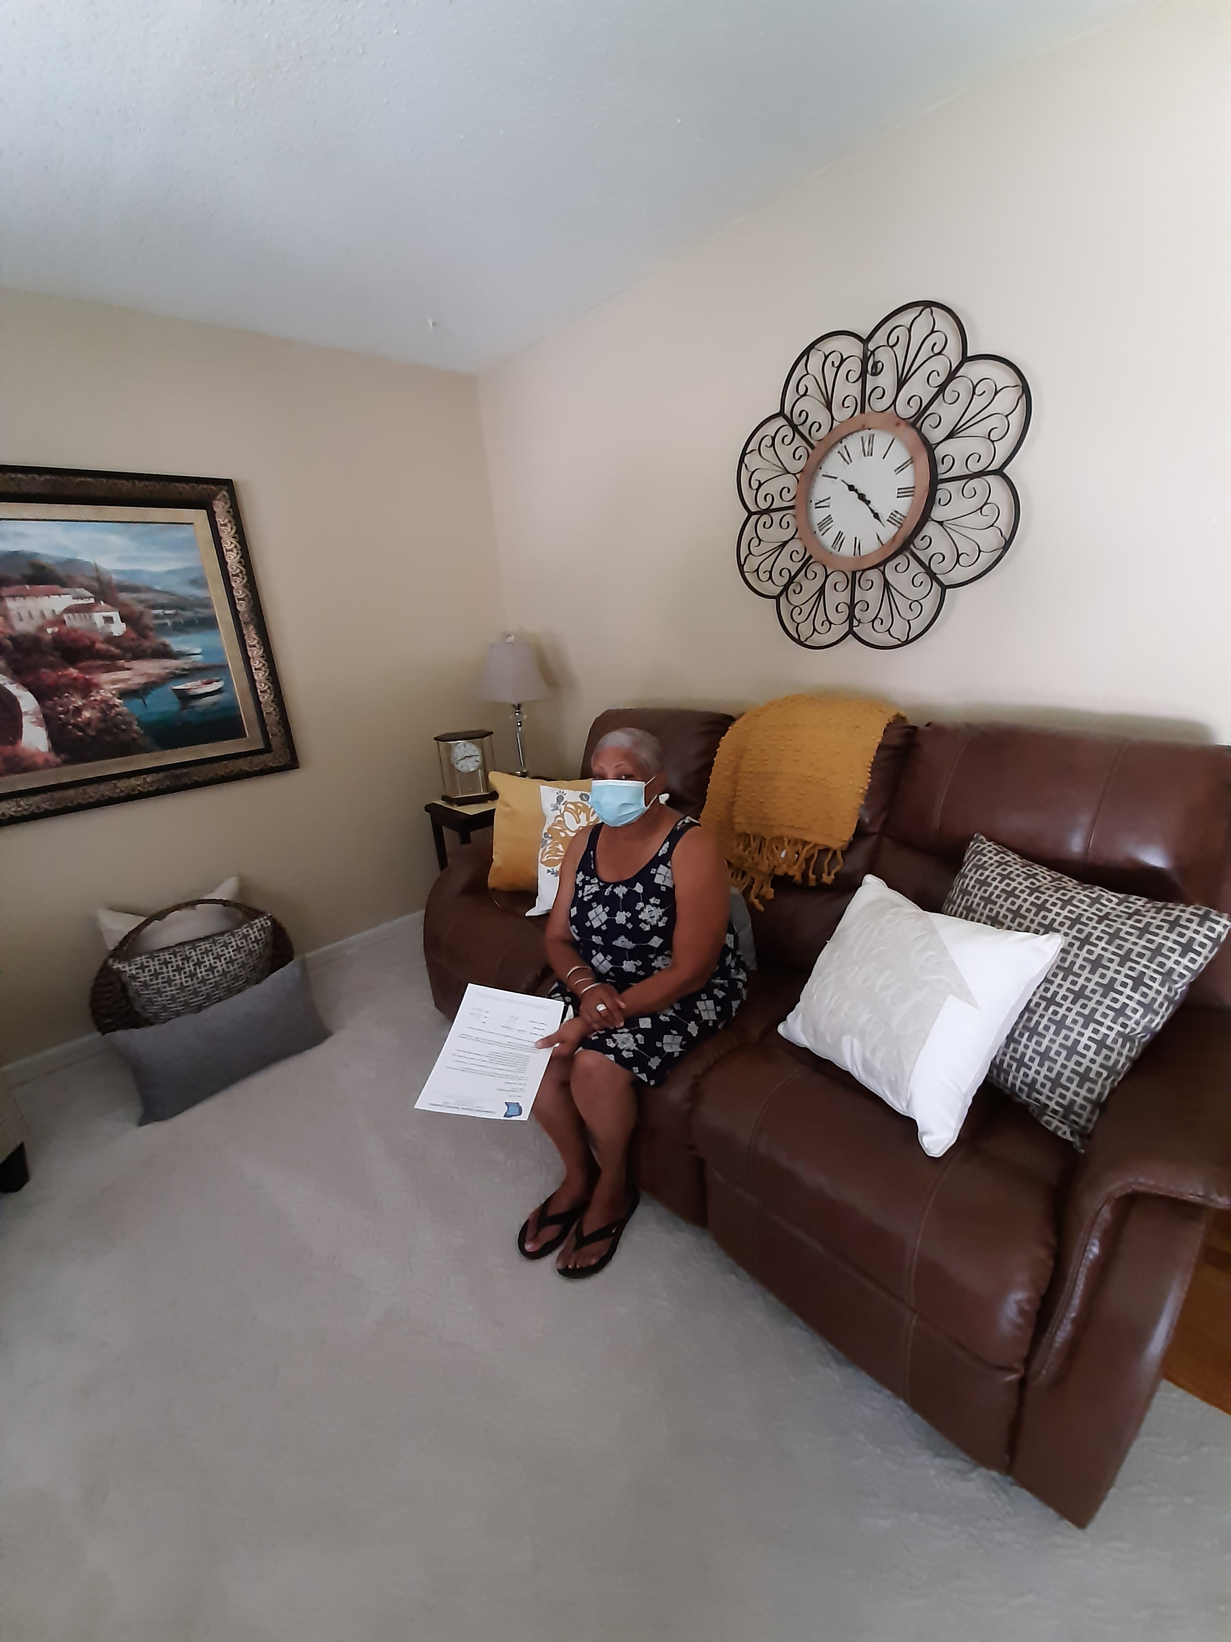
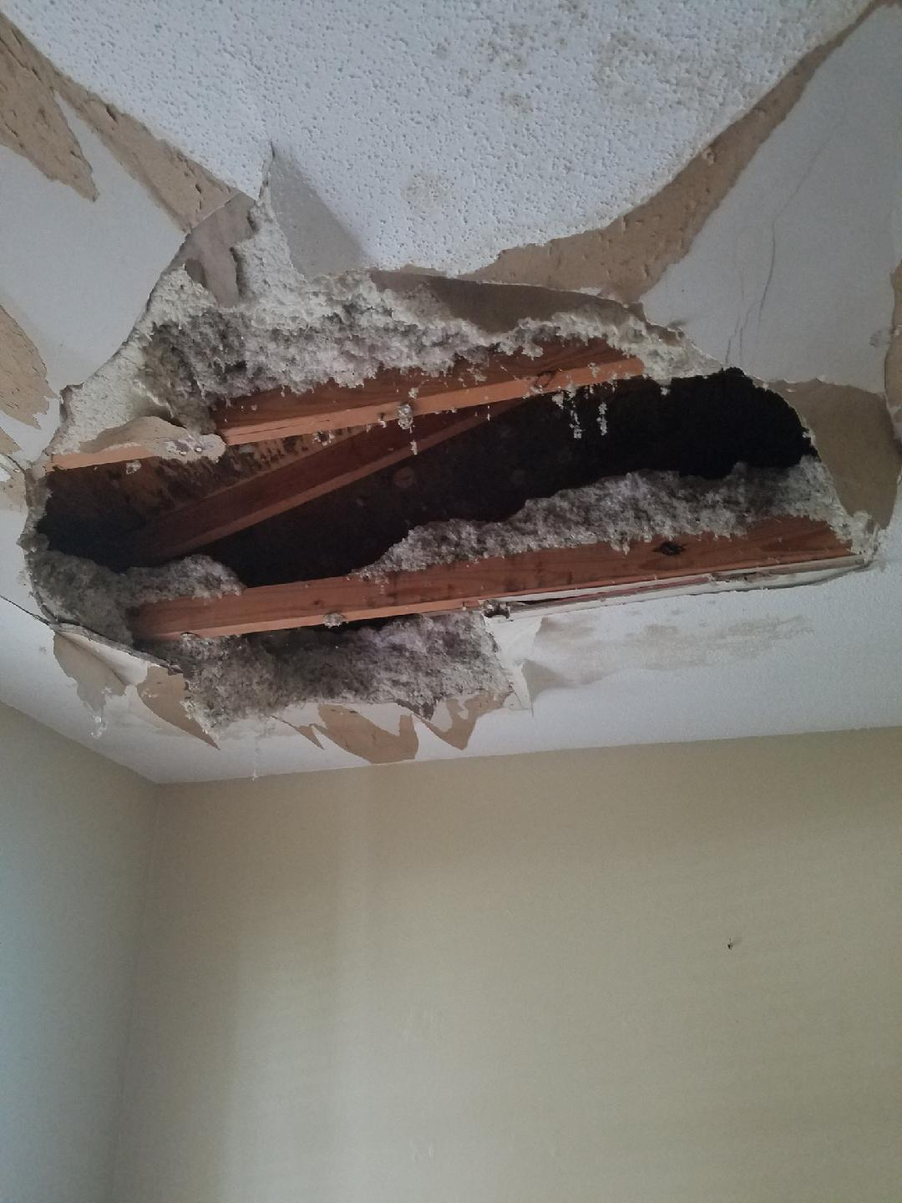
Two Years After Hurricane Florence, “I Finally Have My Home Restored” – A. Williams
“I lost hope and my anxiety levels were high, I never thought I would enjoy my home again,” said Ms. A. Williams.
“I cannot thank CDRC for giving me back my home, no more worrying when it rains, my home is safe again,” exclaimed Ms. Williams.
Ms. Williams had been through several programs (Endeavors, UMCOR & Legal Aid), her case was transferred to CDRC, DCM Treviño worked diligently to find local resources to assist in her recovery process.
Habitat for Humanity assisted with roof and interior repairs for survivor.

Slide 11
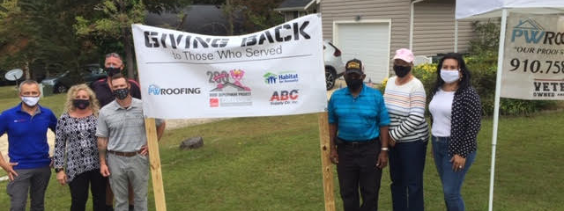
CDRC Giving Back To Those Who Served, By Bringing Partnership Through Community Resources. Thank you Habitat For Humanity, PWRoofing and Owens Corning.
https://abc11.com/disabled-veteran-receives-new-roof-on-50th-wedding-anniversary-/6897566/

Slide 12
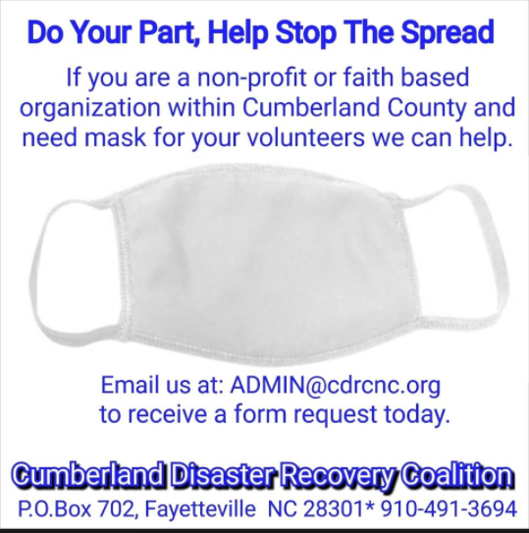
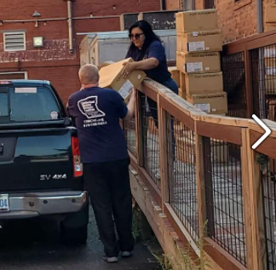
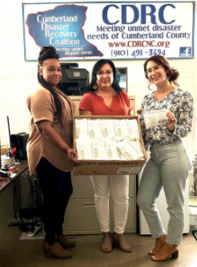
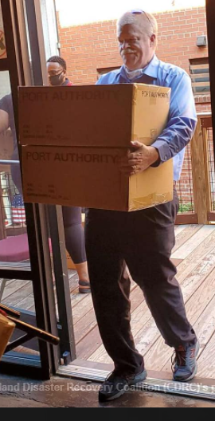
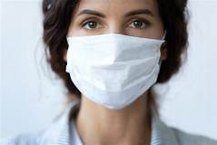
Doing Our Part to Ensure the Safety of Volunteers
Distributing Mask Since June 2020 to Faith Based and Non-Profit Organizations

Slide 13
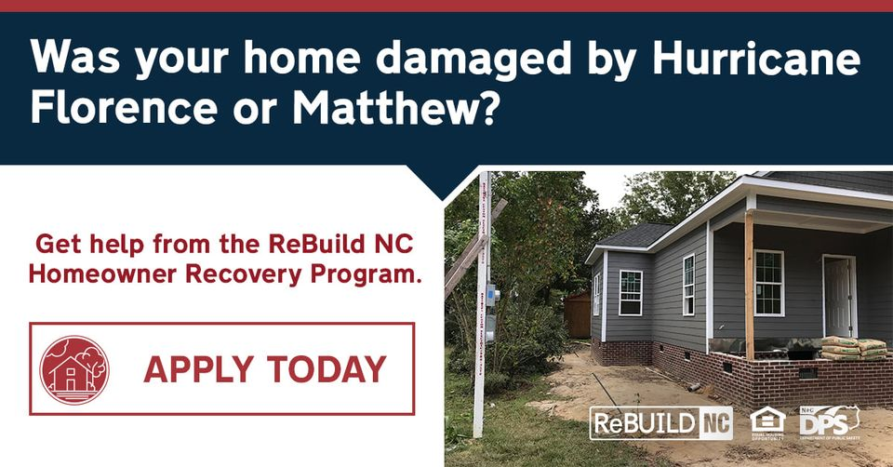
North Carolina Office of Recovery and Resiliency (NCORR) established the Homeowner Recovery Program to help homeowners repair, reconstruct or elevate homes damaged by Hurricane Matthew and Florence.
The program is part of a comprehensive plan to distribute federal community Development Block Grant-Disaster Recovery (CBDG-DR) funds within North Carolina's hardest-hit communities.
Homeowners may be eligible for assistance if they owned and occupied a home during the time of these disasters. If homeowners have received assistance from other sources, they may still be eligible for help.
RebuildNC has developed an online application. People interested in applying to the program should visit ReBuild.NC.Gov.
More information is available by calling 833-ASK-RBNC

Slide 14
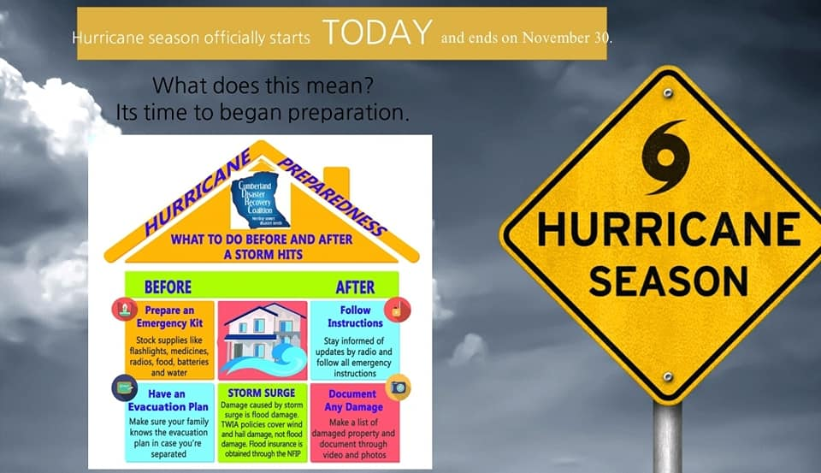
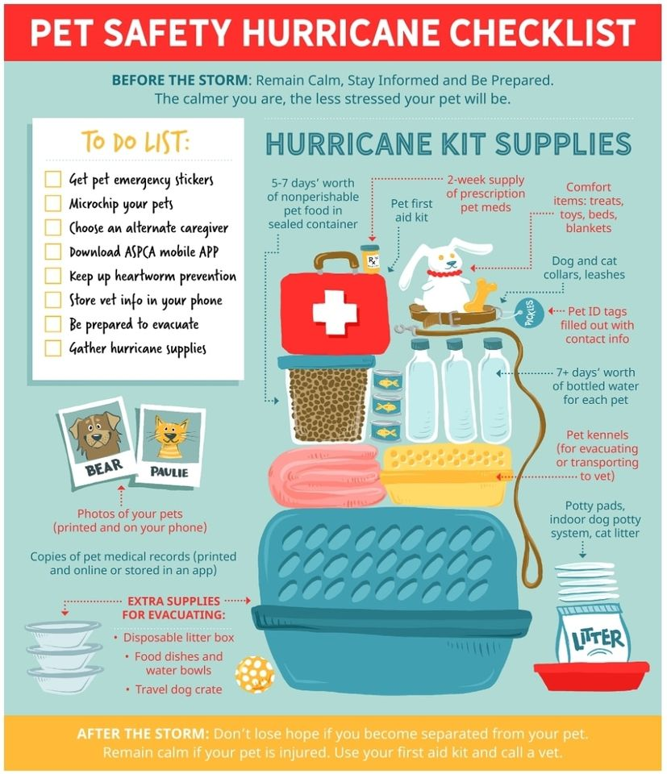

Slide 15






THANK YOU FOR CONTINUOUSLY SUPPORTING DISASTER SURVIVORS UNMET NEEDS

